Slide 1


Intro to GitHub
Dr. Theresa Laverty and Dr. Erica Christensen
31 March 2023

Slide 2

Why should you use GitHub?
Version control
Like an unlimited ‘undo’
Allows many people to work in parallel
Like "Track Changes" but better!

Slide 3
Why should you use GitHub?
Version control
Like an unlimited ‘undo’
Allows many people to work in parallel
Like "Track Changes" but better!
… BUT not the best for large file storage
There are ways to work around this

Slide 4


Slide 5
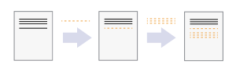
One user:
Icons: https://swcarpentry.github.io/git-novice/01-basics/index.html

Slide 6
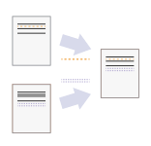
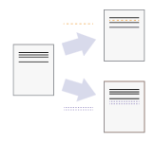
One user:
Two users:
Icons: https://swcarpentry.github.io/git-novice/01-basics/index.html

Slide 7
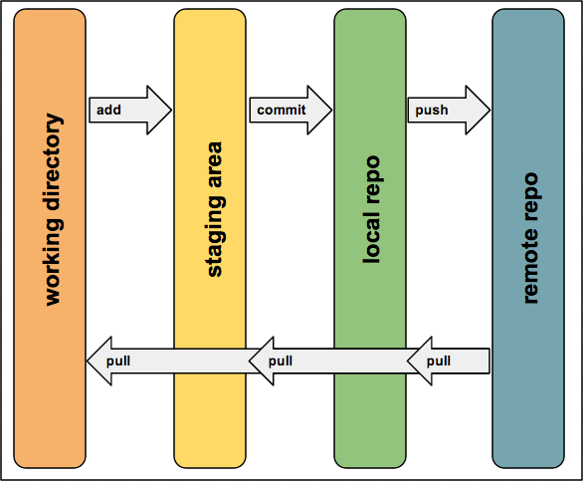
How Git works
Image: https://hwheeler01.github.io/CompBio/github/

Slide 8

Image: https://www.nobledesktop.com/blog/what-is-git-and-why-should-you-use-it

Slide 9
Git glossary: https://git-scm.com/docs/gitglossary
commit
As a noun: A single point in the Git history; the entire history of a project is represented as a set of interrelated commits. The word "commit" is often used by Git in the same places other revision control systems use the words "revision" or "version". Also used as a short hand for commit object.
As a verb: The action of storing a new snapshot of the project’s state in the Git history, by creating a new commit representing the current state of the index and advancing HEAD to point at the new commit.
push
Pushing a branch means to get the branch’s head ref from a remote repository, find out if it is an ancestor to the branch’s local head ref, and in that case, putting all objects, which are reachable from the local head ref, and which are missing from the remote repository, into the remote object database, and updating the remote head ref. If the remote head is not an ancestor to the local head, the push fails.
pull
Pulling a branch means to fetch it and merge it.
pull request
An event in Git where a contributor asks a maintainer of a Git repository to review code they want to merge into a project.

Slide 10
Git glossary: https://git-scm.com/docs/gitglossary
branch
A "branch" is a line of development. The most recent commit on a branch is referred to as the tip of that branch. The tip of the branch is referenced by a branch head, which moves forward as additional development is done on the branch. A single Git repository can track an arbitrary number of branches, but your working tree is associated with just one of them (the "current" or "checked out" branch), and HEAD points to that branch.
master
The default development branch. Whenever you create a Git repository, a branch named "master" is created, and becomes the active branch. In most cases, this contains the local development, though that is purely by convention and is not required.
fork
Another way of saying clone or copy. The term fork (in programming) derives from a Unix system call that creates a copy of an existing process. So, unlike a branch, a fork is independent from the original repository. If the original repository is deleted, the fork remains. If you fork a repository, you get that repository and all of its branches.
origin
The default upstream repository. Most projects have at least one upstream project which they track. By default origin is used for that purpose. New upstream updates will be fetched into remote-tracking branches named origin/name-of-upstream-branch, which you can see using git branch -r.

Slide 11
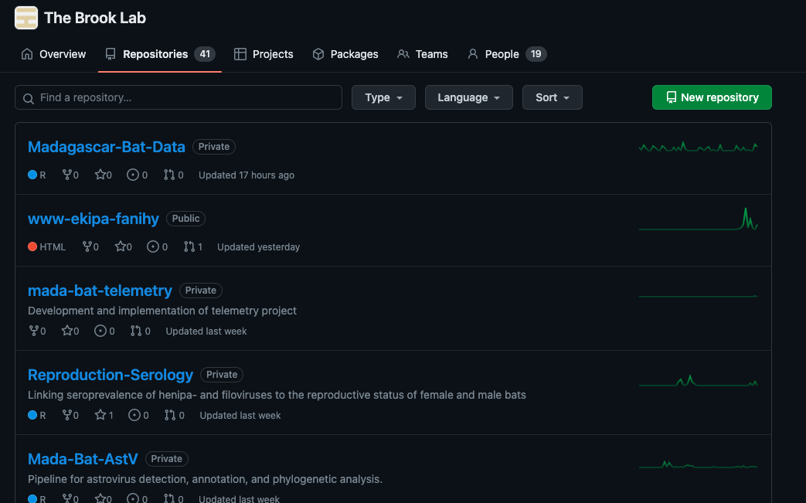
Theresa's experience with GitHub
Working collaboratively and independently on code largely within repositories hosted on an organization's GitHub page
Brook Lab and Laverty Lab

Slide 12


Theresa's experience with GitHub
Working collaboratively and independently on code largely within repositories hosted on an organization's GitHub page
Brook Lab and Laverty Lab
Hosting our lab's website: https://github.com/LavertyLab/lab-website

Slide 13
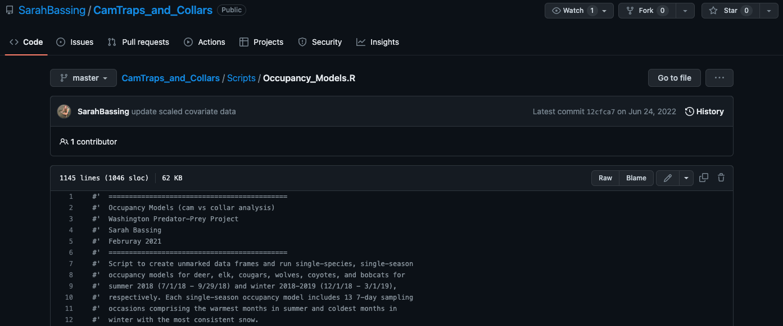
Theresa's experience with GitHub
Working collaboratively and independently on code largely within repositories hosted on an organization's GitHub page
Brook Lab and Laverty Lab
Hosting our lab's website
Creeping on other people's code and lecture materials

Slide 14
Erica's experience with GitHub
Code storage
Easy to send a link to collaborators
Easy to move between work and home computers

Slide 15
Erica's experience with GitHub
Code storage
Easy to send a link to collaborators
Easy to move between work and home computers
Using GitHub to house collective lab data sets
Prevents "accidents" when adding to a dataset
Any changes to dataset have to be looked at and approved by another person

Slide 16
Erica's experience with GitHub
Code storage
Easy to send a link to collaborators
Easy to move between work and home computers
Using GitHub to house collective lab data sets
Prevents "accidents" when adding to a dataset
Any changes to dataset have to be looked at and approved by another person
Versioning code and archiving on Zenodo to get a DOI to cite in papers

Slide 17

Interactive Tasks
Create a new repository and clone to your computer
Make changes, commit changes, and push to GitHub
Review/change .gitignore
Revert changes https://intro2r.com/use_git.html
Fork an existing repository and clone to your computer
Make a pull request
Resolve a merge conflict
Add a collaborator to a repository/organization
Publish repository: DOI link generation https://coderefinery.github.io/github-without-command-line/doi/

Slide 18

Some best practices
ALWAYS pull before you push
Designate one member to maintain the primary repository
All other members fork the primary repository and clone it to their local machine/home directory
Any changes made by other members can be submitted as pull requests to the primary repository owner
Primary owner can decide whether to accept the changes or not
This way, multiple copies of your code will be floating around in case one member does something stupid and deletes their entire repository
Guidance: https://hwheeler01.github.io/CompBio/github/

Slide 19
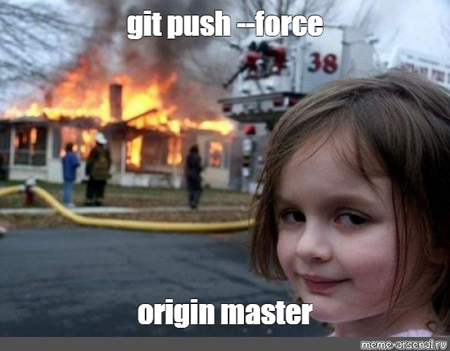
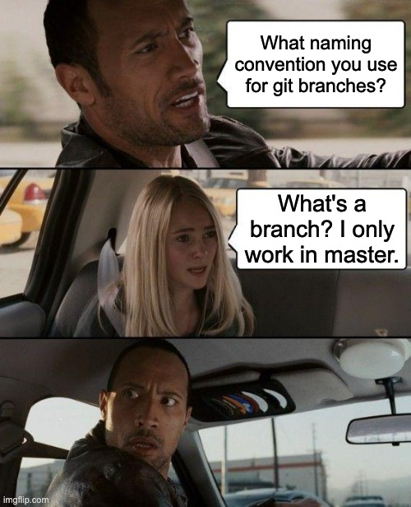

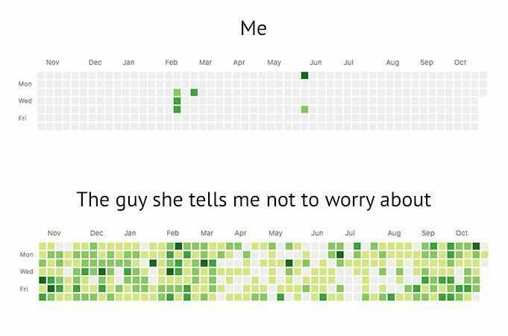
Git going!

Slide 20


Contact us 1 tlaverty@nmsu.edu; echriste@nmsu.edu Helpful references: - https://happygitwithr.com / - https://swcarpentry.github.io/git-novice/ - https://docs.github.com/en

